Slide 1
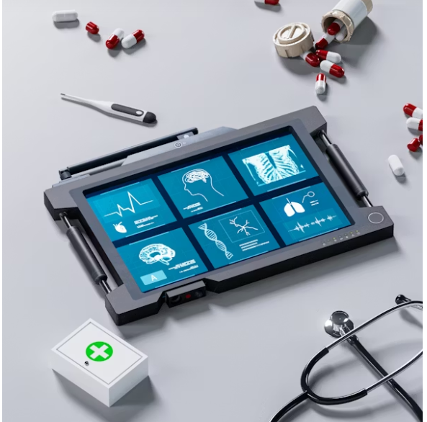
Building a Customer Service Ticket & SLA Optimization System for Northbridge Health Services Ltd
Group 2 (BLUE TEAM)

Slide 2
Sub topics
Ticket Demand
Operational Performance
SLA Compliance
Escalation Risk
Workforce Capacity
Future Forecasting

Slide 3

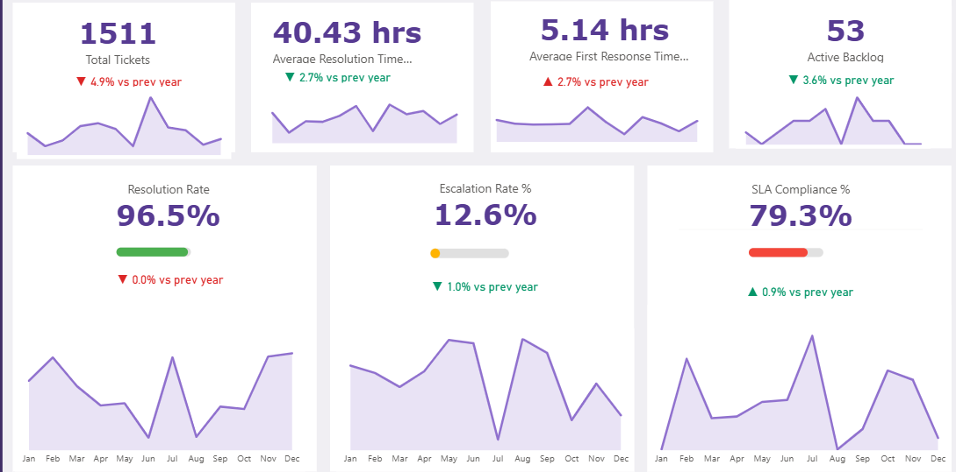
EXECUTIVE OVERVIEW
INSIGHT
Northbridge processed 1,511 customer support tickets in 2024.
Average First Response Time stands at 5.14 hours.
Average Resolution Time stands at 40.43 hours.
SLA Compliance achieved 79.3%, below the desired service target of 90%.
Escalation Rate remains at 12.6%.
Resolution Rate reached 96.5%, indicating that most tickets are ultimately resolved
.BUSINESS IMPACT
Most customer issues are successfully resolved.
Service performance challenges stem from timeliness rather than resolution capability.
SLA breaches and escalations indicate inefficiencies within operational processes.
Current backlog levels remain manageable
.RECOMMENDATIONS
Establish an SLA Compliance Improvement Programme.
Reduce response and resolution times through workflow optimization.
Target high-volume service categories for process redesign
Northbridge resolves most customer issues successfully; however, improving SLA performance and reducing escalations remain the organization's primary operational priorities.

Slide 4
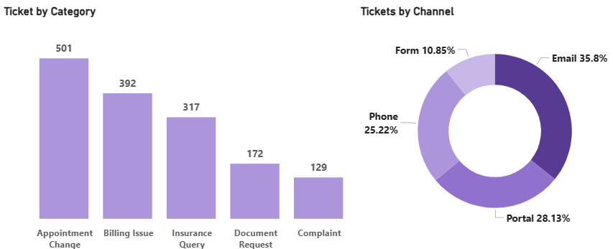
UNDERSTANDING CUSTOMER DEMAND
KEY INSIGHTS
Appointment Change generated 501 tickets and represents the largest demand driver
Billing Issues generated 392 tickets
Insurance Queries generated 317 tickets.
Email accounts for 35.8% of all customer interactions
BUSINESS IMPACT
High-volume transactional requests consume valuable support capacity. Skilled support staff are spending time on repetitive administrative tasks.
RECOMMENDATIONS
Introduce self-service appointment scheduling.
Automate routine billing enquiries.
Expand digital self-service capabilities through the customer portal..
The biggest opportunity is not handling tickets faster—it is preventing avoidable tickets from being created

Slide 5
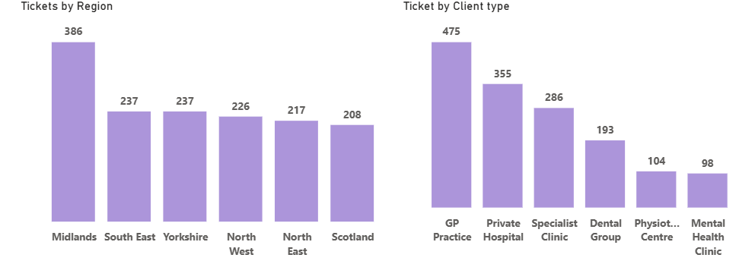
CUSTOMER & REGIONAL DEMAND CONCENTRATION
KEY INSIGHTS
Midlands generated the highest ticket volume with 386 tickets.
GP Practices generated 475 tickets and represent the largest customer segment.
Ticket demand is concentrated among specific customer groups and locations.
BUSINESS IMPACT
Uneven demand creates regional service pressure.
Resource allocation may not align with actual demand patterns.
RECOMMENDATIONS
Allocate resources based on regional demand trends.
Develop targeted service improvement initiatives for GP Practices.
Monitor regional workload distribution quarterly.
Customer demand is not evenly distributed, and support resources should not be either.

Slide 6
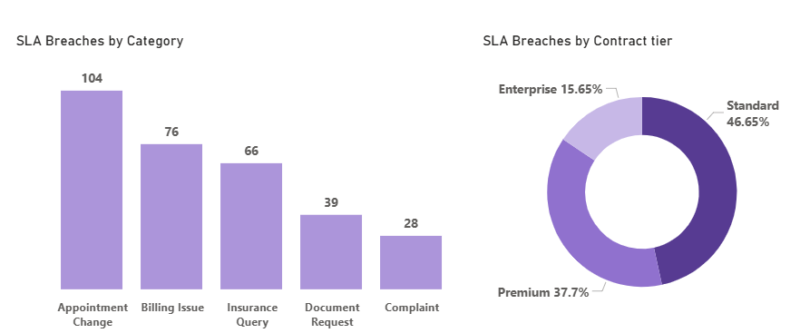
SLA RISK & SERVICE PERFORMANCE
KEY INSIGHTS
SLA Compliance stands at 79.3%, below the typical service target of 90%.
A total of 313 SLA breaches were recorded during the reporting period.
Standard contract customers account for 46.7% of all SLA breaches.
Appointment Change requests generated the highest number of breaches (104 breaches)..
BUSINESS IMPACT
SLA failures are concentrated within specific contract tiers and service categories.
Standard-tier customers represent the greatest operational risk exposure.
Repeated breaches increase the likelihood of customer dissatisfaction and reputational damage
. RECOMMENDATIONS
Conduct a targeted review of Standard contract service processes
Prioritize Appointment Change workflows for process redesign and automation.
Introduce proactive SLA alerts for high-risk ticket categories.
Most SLA failures originate from a small number of contract types and service categories. Addressing these areas will deliver the greatest improvement in service performance.

Slide 7
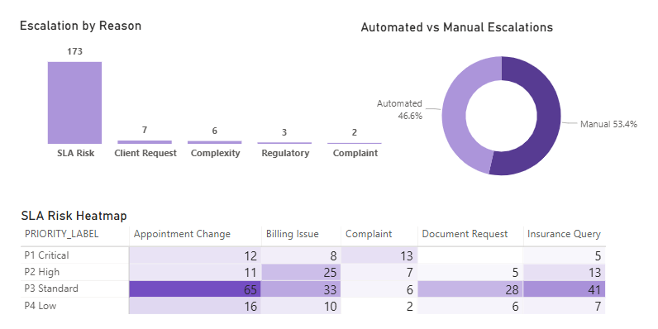
Escalation Risk & Automation Opportunity
KEY INSIGHTS
SLA Risk is responsible for 173 escalations, significantly more than any other escalation reason.
Manual escalations account for 53.4% of all escalations.
The heatmap shows that P3 Standard Appointment Change tickets represent the largest concentration of SLA risk..
BUSINESS IMPACT
Escalations are being driven primarily by process failures rather than ticket complexity.
Manual intervention increases operational costs and extends resolution times.
A small number of ticket-priority combinations consume a disproportionate amount of management attention.
RECOMMENDATIONS
Automate escalation workflows for recurring SLA-risk scenarios.
Review service processes for P3 Standard Appointment Change tickets.
Establish automated routing and prioritization rules to reduce manual intervention.
Northbridge's escalation challenge is largely operational rather than technical. The data indicates that automation and process redesign will deliver greater value than additional staffing.

Slide 8
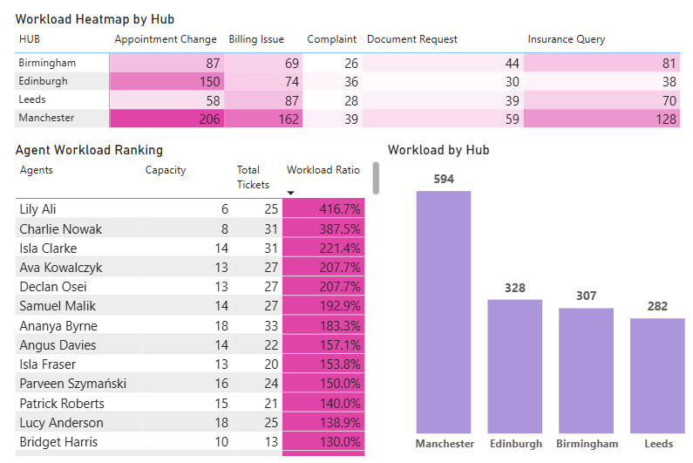
WORKFORCE CAPACITY & RESOURCE OPTIMISATION
KEY INSIGHTS
Northbridge operates with 114 active agents and overall capacity utilization of 60%.
Manchester processes 594 tickets, nearly double the workload of some other hubs.
Agent utilization varies significantly, ranging from below 10% to over 400%.
Several agents are handling more than twice their assigned capacity, while others remain substantially underutilized.
BUSINESS IMPACT
Current workforce capacity is sufficient to meet demand.
Service performance risks are being driven by workload distribution rather than headcount limitations.
Overloaded agents are more likely to experience delays, reduced productivity, and burnout.
Underutilized capacity represents a missed opportunity to improve service efficiency.
RECOMMENDATIONS
Introduce workload-balancing rules across hubs and support teams.
Implement automated ticket routing based on agent availability, capacity, and expertise.
Establish utilization thresholds to identify overloaded and underutilized agents early.
Review workforce allocation monthly to ensure capacity is distributed effectively.
The organisation does not need more capacity—it needs better utilization of existing capacity..

Slide 9
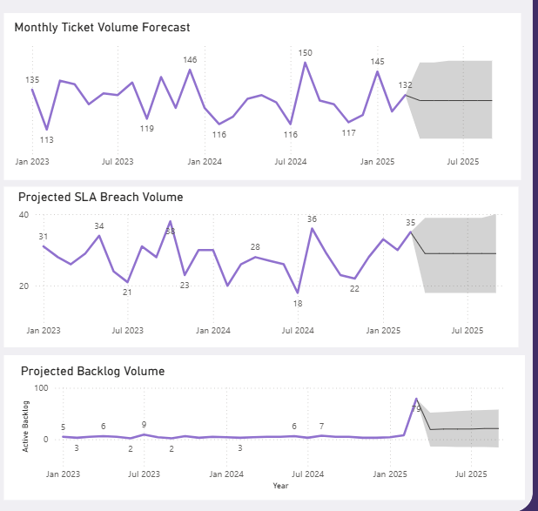
FORECASTING & STRATEGIC PLANNING
KEY INSIGHTS
Monthly ticket demand is forecast to remain stable at approximately 126 tickets.
SLA breaches are expected to remain around 26 per month.
Backlog levels are projected to remain manageable
Ticket demand has declined by 5% year-over-year
.BUSINESS IMPACT
No immediate workforce expansion is required.
Current operational trends are sustainable.
Future performance gains will depend on process improvements rather than additional staffing.
RECOMMENDATIONS
Maintain current staffing levels. • Prioritize automation initiatives. • Continue monitoring SLA risk indicators...
The future challenge is not managing growth—it is improving efficiency.

Slide 10
FINAL RECOMMENDATIONS & BUSINESS VALUE
TOP PRIORITIES
Improve SLA Compliance in High-Risk Categories
Automate Appointment Change Requests
Reduce Manual Escalations
Rebalance Workload Across Agents and Hubs
Implement Intelligent Ticket Routing
Expand Customer Self-Service Capabilities
EXPECTED BUSINESS BENEFITS
Reduced SLA Breaches
Higher SLA Compliance
Improved Customer Experience
Better Workforce Utilization
Lower Operational Costs
Faster Service Delivery
Improved Decision-Making
Reduced Escalation Volumes

Slide 11
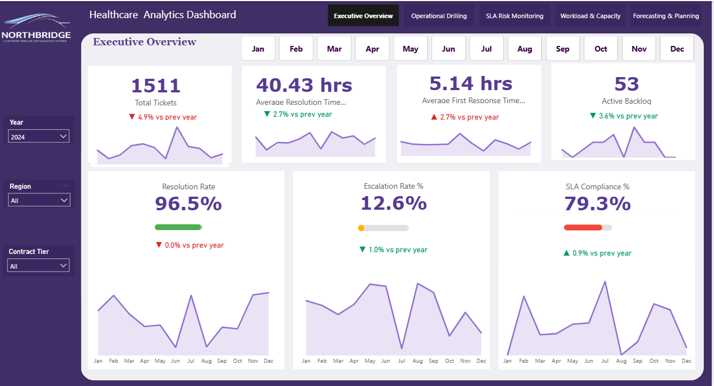

Slide 12
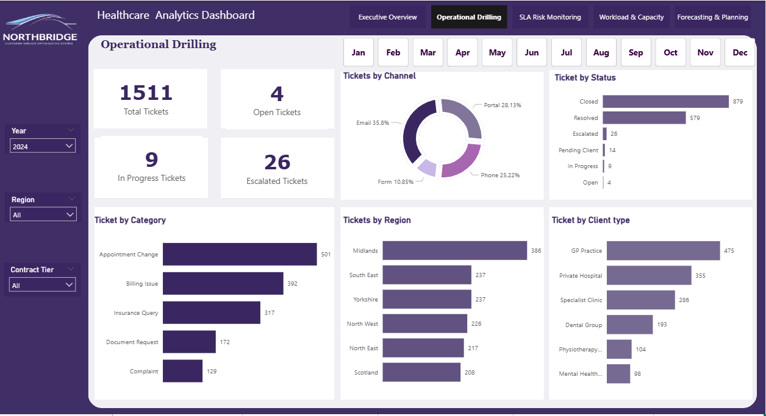

Slide 13
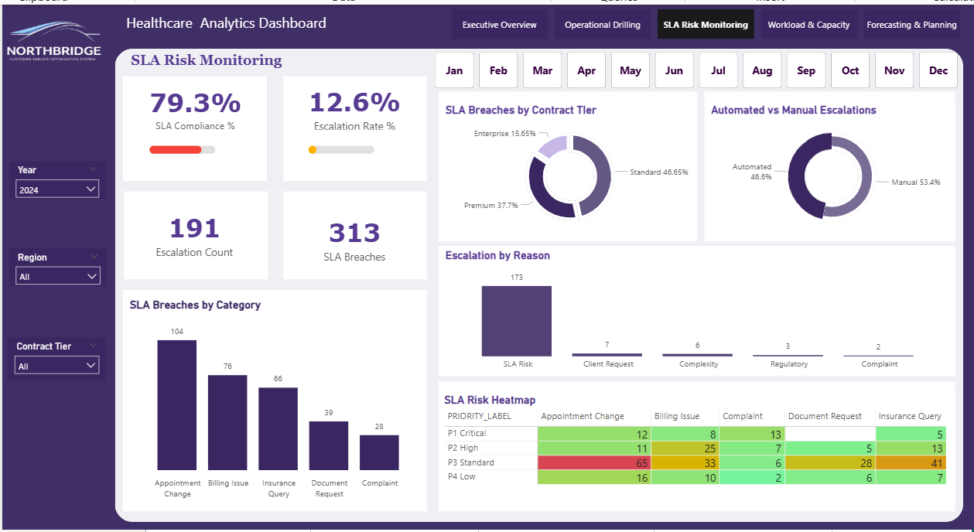

Slide 14
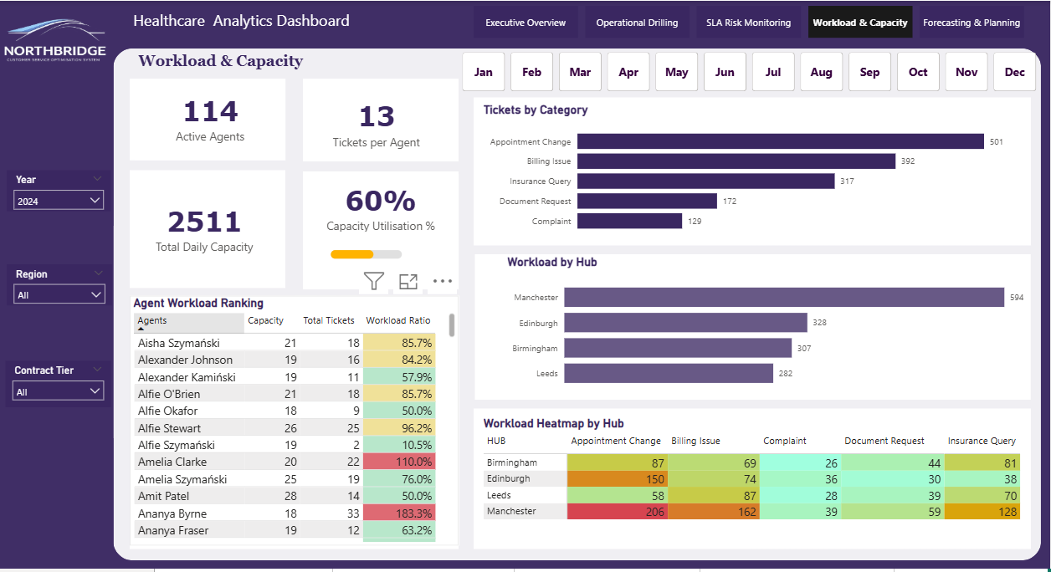

Slide 15
